Slide 1
eSign Documents Now
Notes:
The first method is to eSign Documents now.

Slide 2
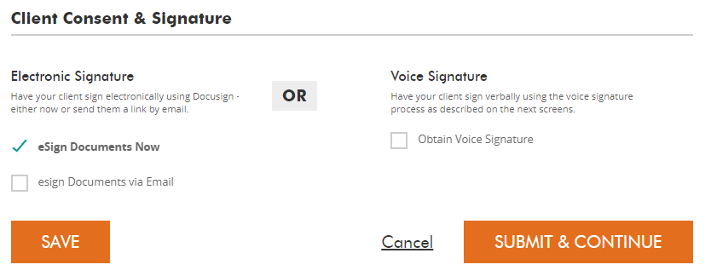
eSign documents now
Notes:
Check eSign Documents Now then click Submit and Continue for this method.

Slide 3
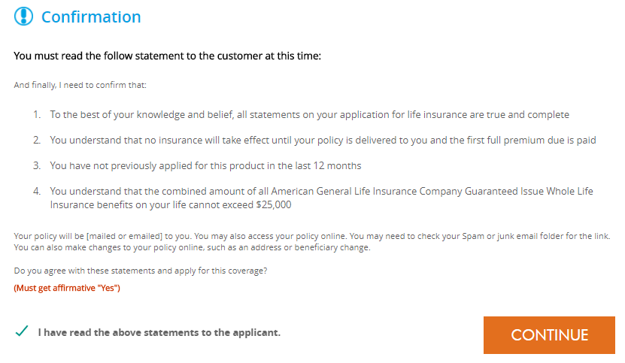
eSign documents now
Notes:
Once you have decided to eSign Documents now, you will need to read the following message to the applicant and check agree before clicking continue.

Slide 4
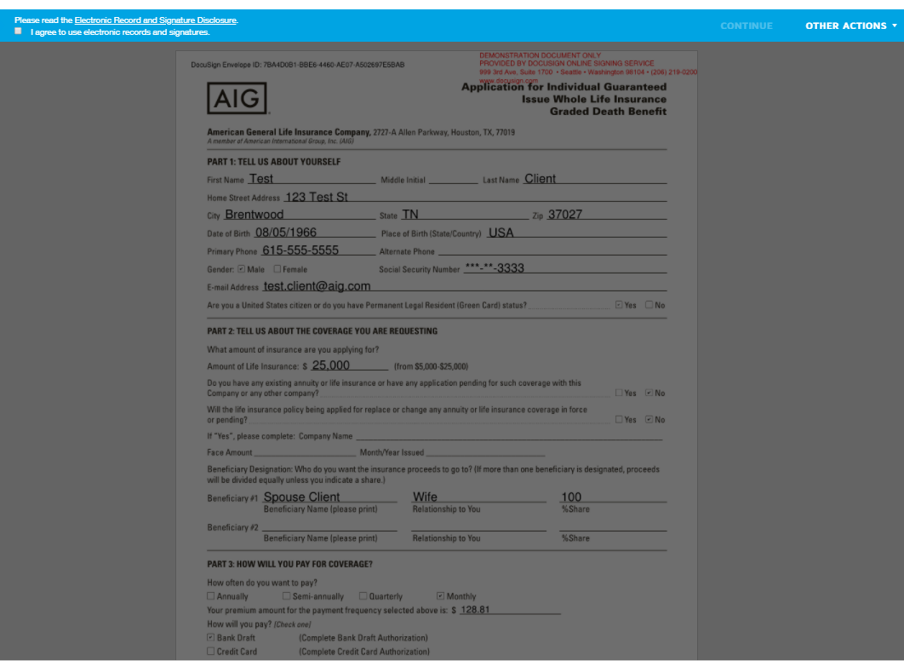
eSign documents now
Notes:
Once we submit and continue, you will need to agree to use the electronic records and signatures.
Once you click there, you can click Continue to bring up the filled out, PDF version of the application.

Slide 5
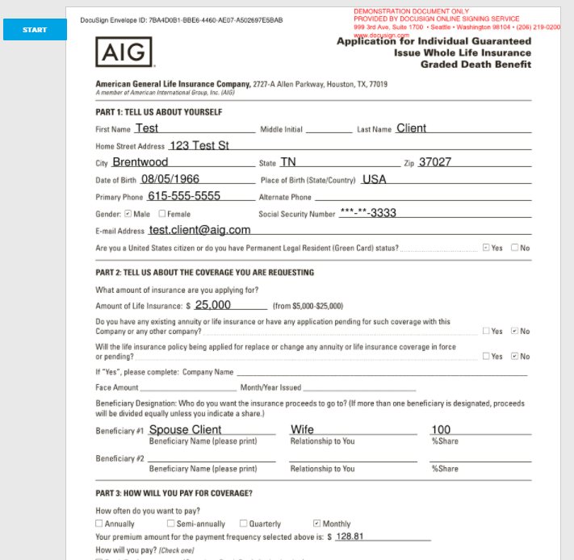
eSign documents now
Notes:
To get the signatures of the client that applied you need to click on Start towards the top.

Slide 6
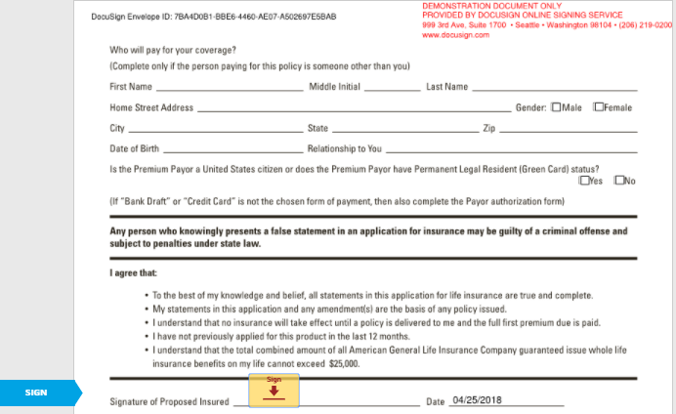
eSign documents now
Notes:
That will bring you to the first signature area.
Click on the little sign red arrow there

Slide 7
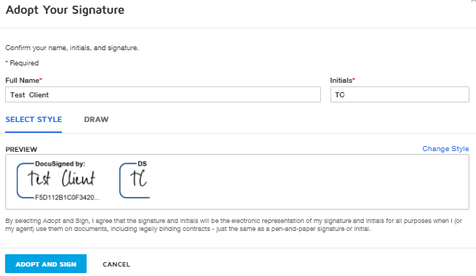
eSign documents now
Notes:
And that will bring up your DocuSign options. DocuSign will prepopulate signatures for you there that you can utilize simply by clicking “Adopt and Sign”. You will notice there is a Draw option as well. If you are on an phone or tablet you can have the client use their finger or a stylus to sign it with that option.

Slide 8
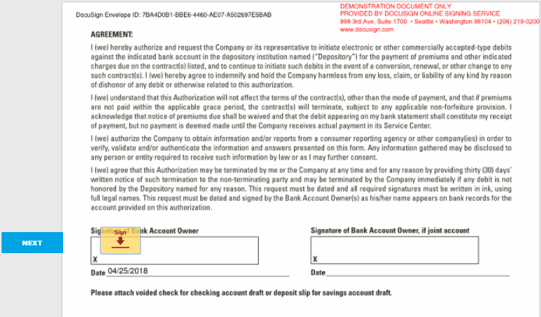
eSign documents now
Notes:
If you click Adopt and Sign that is going to populate all the necessary signatures in the application. Once that is complete you click on Finish and that ends the signature process

Slide 9
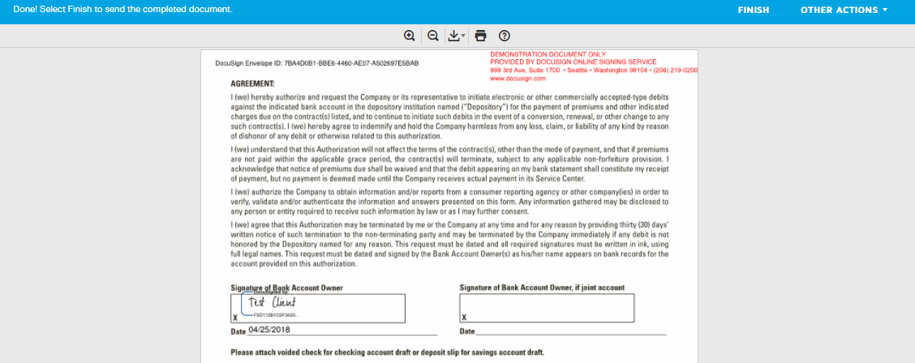
eSign documents now
Notes:
If you click Adopt and Sign that is going to populate all the necessary signatures in the application. Once that is complete you click on Finish and that ends the signature process

Slide 10
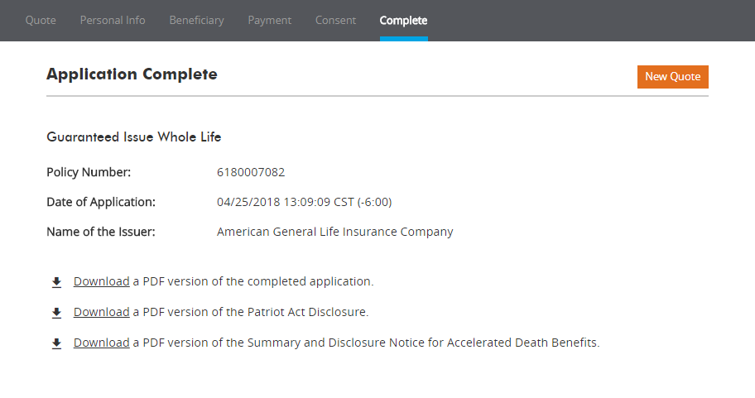
eSign documents now
Notes:
After each of those steps you will be notified that the application is complete and be provided the option to download the completed forms for you and your clients records.

Slide 11
eSign Documents via Email
Notes:
Another way to complete the application is to eSign Documents via Email.

Slide 12
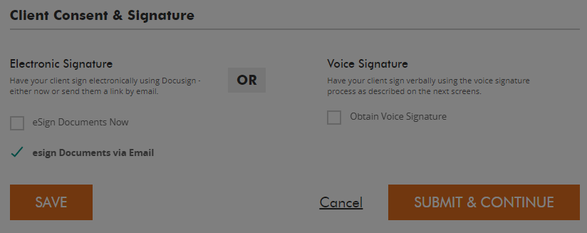
eSign documents via email
Notes:
Choose eSign Documents via email then click Submit and Continue for this method.

Slide 13
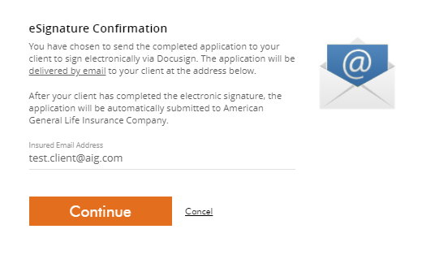
eSign documents via email
Notes:
After selecting that submission method, you will be given an eSignture Confirmation screen that outlines the details of this process as well as the email address of the insured that the information is going to go to.
Click Continue to move on.

Slide 14
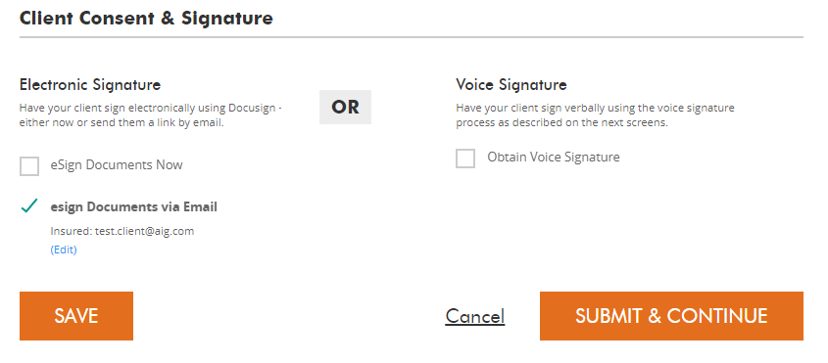
eSign documents via email
Notes:
After that, you will be taken back to the Client Consent & Signature screen where you need to click Submit and Continue.

Slide 15
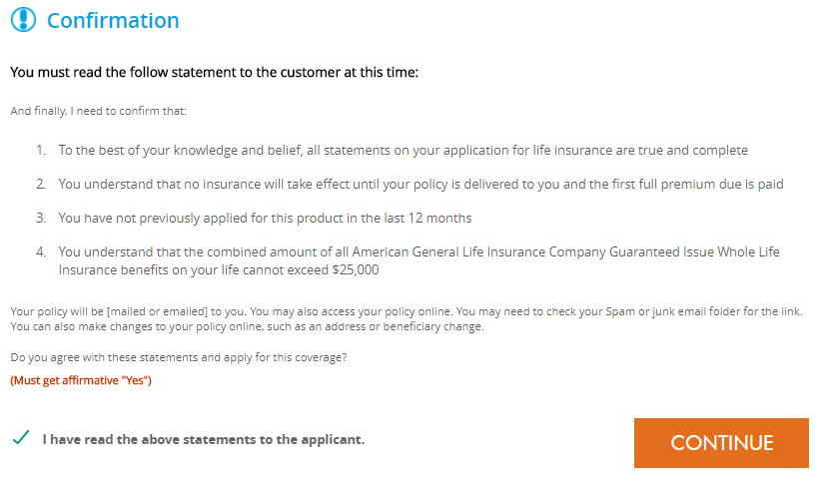
eSign documents via email
Notes:
You then will see the confirmation screen again where you must read the statements to the customer, check that you have done so, then click continue.

Slide 16
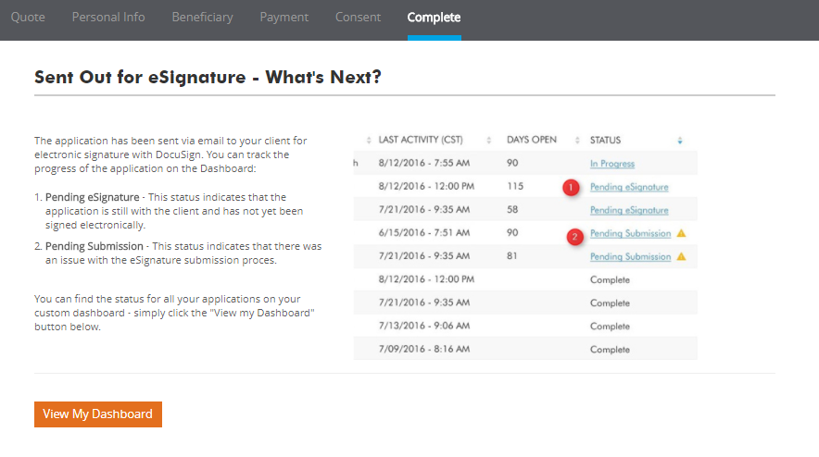
eSign documents via email
Notes:
Finally, you will get the details about what is next.
This screen notifies you that the application has been sent via email to your client for electronic signature and shows you how to track the progress of the application on the Dashboard, all the way up until the process has been completed by the client.

Slide 17
Online Application Process Voice Signature
Notes:
The final way to complete the online application is by using a voice signature. So if you utilize or if you have voice recording with your firm this would also be a viable option for obtaining the signatures.

Slide 18
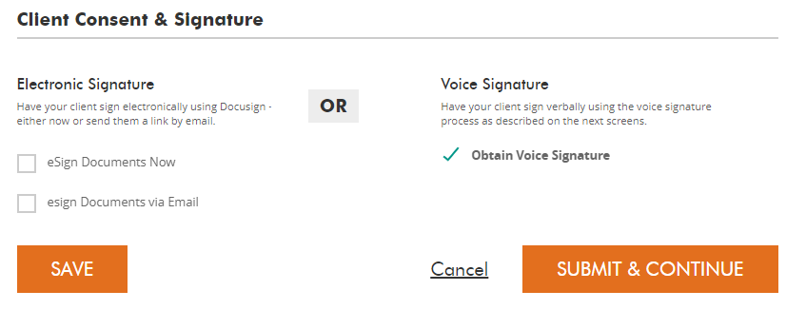
Obtain voice signature
Notes:
For this method, select Obtain Voice Signature then click Submit and Continue.

Slide 19
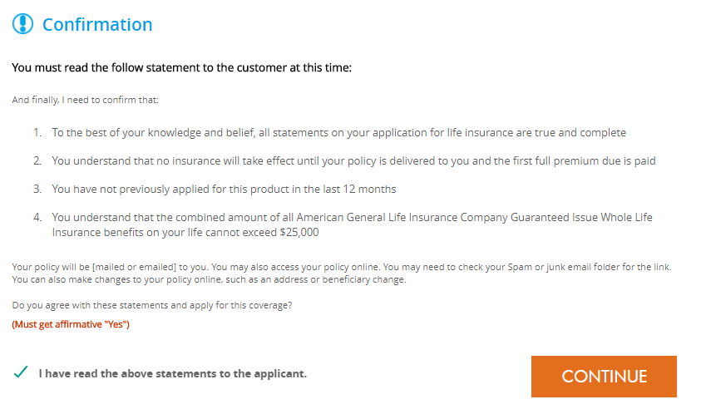
Obtain voice signature
Notes:
You must again read these statements to your customer at this time, check that you have done so, the click Continue

Slide 20
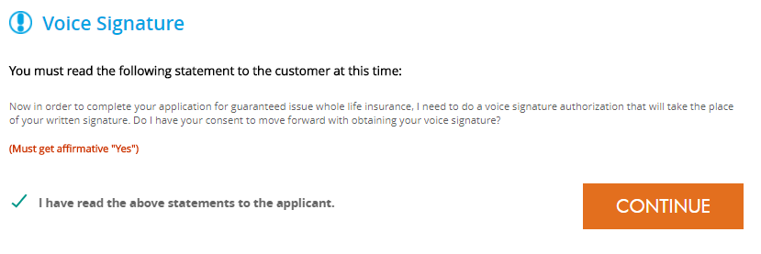
Obtain voice signature
Notes:
Because of the signature type, there is another voice signature disclosure that you must read to the customer, check that you have done so, then click continue.

Slide 21
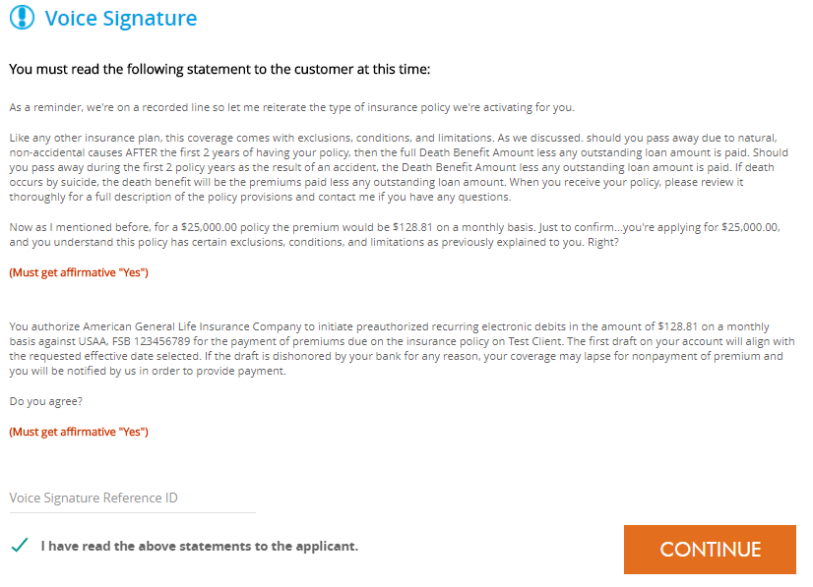
Obtain voice signature
Notes:
Here are more disclosures now for the voice signature process that have to be competed and read to the customer at this time.
You also see there is an area you are going to need to enter the Voice Signature Reference ID which links that recorded voice signature to this application for recordkeeping and legal purposes.
Once you have that, click Continue and you will have another statement that has to be read to the customer at this time. Check the box, click continue and it is now complete and you will end up at the same screen where you can download the application.

Slide 22
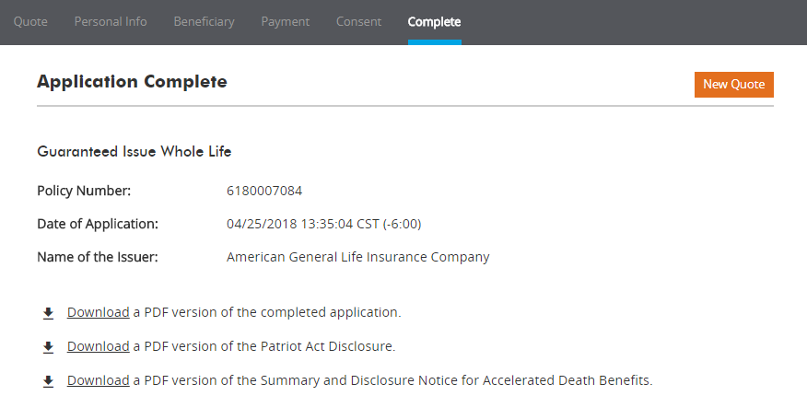
Obtain voice signature
Notes:
The final step in this process shows that the application is complete and provides links for you to download copies of the application and disclosures for you and your client.

Slide 23
Policies issued by American General Life Insurance Company (AGL), Houston, TX. Policy Forms: ICC20-20532, 20532, 20532-5, and 20532-10. Rider Numbers: ICC15-15200, 15200, 15200-7, 15200-10, 15200-35, ICC15-15201, 15201, 15201-7, 15201-9, 15201-10, and 15201-35. Issuing company AGL is responsible for financial obligations of insurance products and is a member of American International Group, Inc. (AIG). Guarantees are backed by the claims-paying ability of the issuing insurance company. AGL does not solicit business in the state of New York. Products may not be available in all states and product features and rates may vary by state. © 2020 AIG. All rights reserved.
AGLC200485-eSig
Notes:
Read Slide

